Slide 1
Social Software Testing Approaches
Maaret Pyhäjärvi

Slide 2
What Social at Work Usually Looks Like
Planning
PI Planning
Sprint Planning
Backlog Refinement
Three Amigos Sessions
Daily Meetings
Hallway Whiteboarding
Doing ???
Traditional Pair Testing
Strong-Style Pair Testing
Ensemble (Mob) Testing
Bug Bashes
GenAI Pair Testing
Notes:
1.00 – 4:00
https://bbst.courses/blog/social-software-testing-approaches/

Slide 3
Why?
Co-generate options
Choose to try, choose through doing
Practice (doing) over theory (plan)
Avoid ping-pong
Timely feedback
Build more skilled empathetic colleagues
Notes:
4:00-6.24

Slide 4
Resistance!
Notes:
6:24-7:46

Slide 5
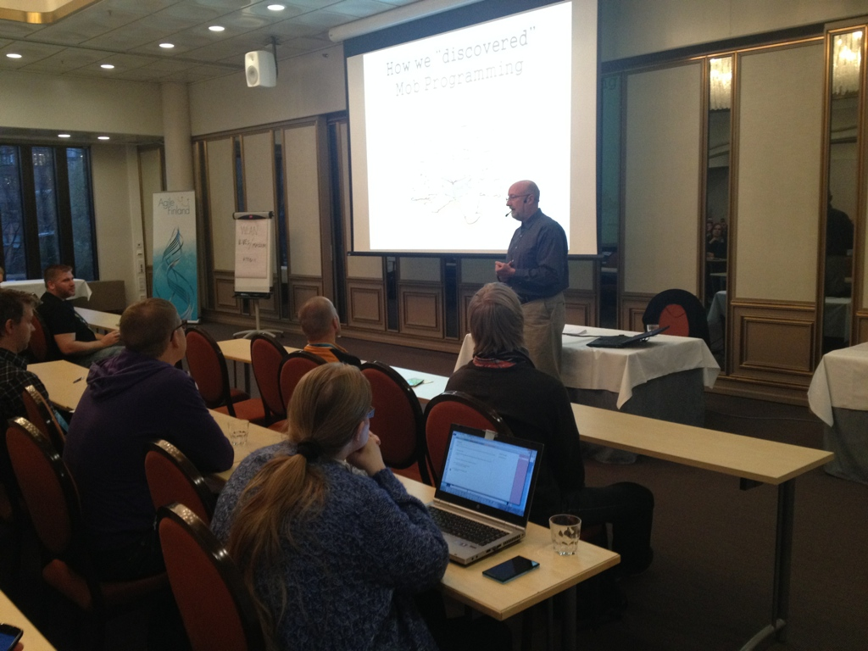
A talk on a strange idea:
Mob Programming
Notes:
7:46-8:48

Slide 6
“A ridiculous idea - I need to experience it 1st hand”
Notes:
8:48-10:30

Slide 7
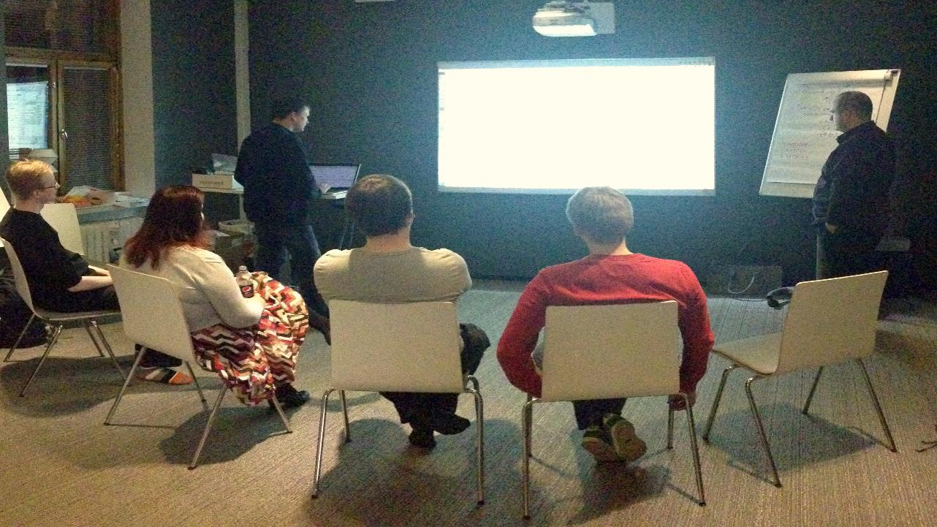
Notes:
10:30-13:27

Slide 8
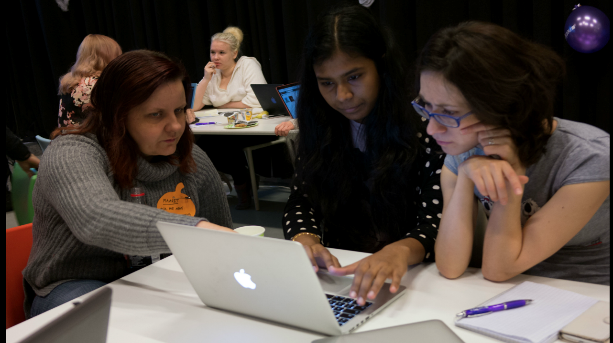
Notes:
13:27-14:02

Slide 9
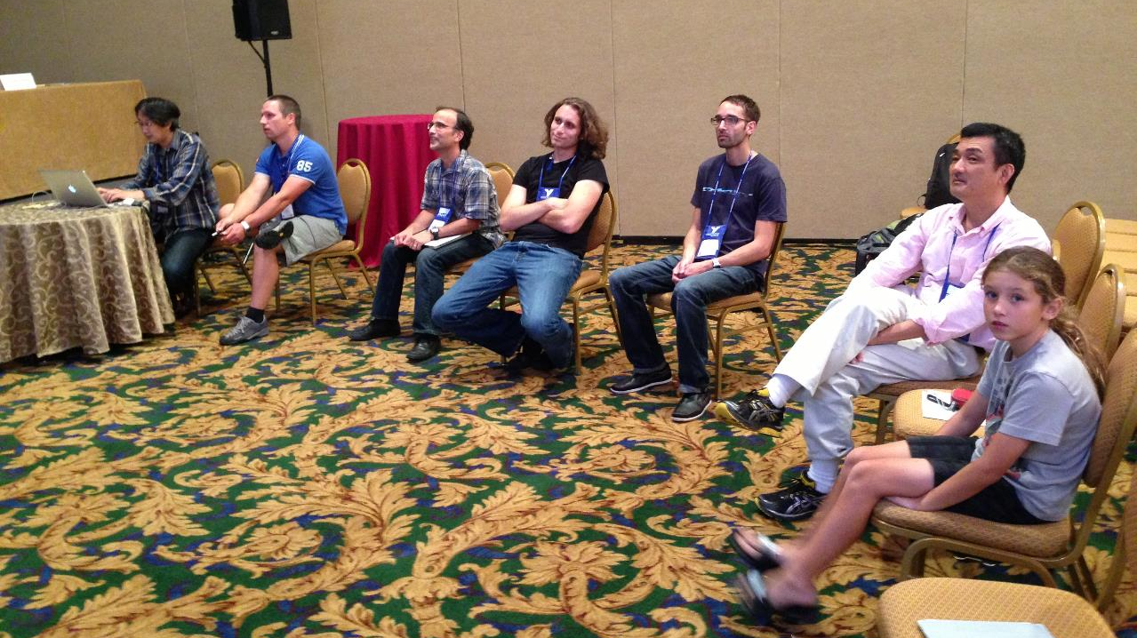
Notes:
14:02-14:37

Slide 10
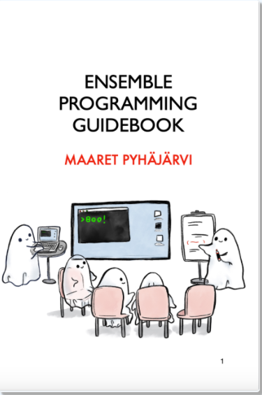
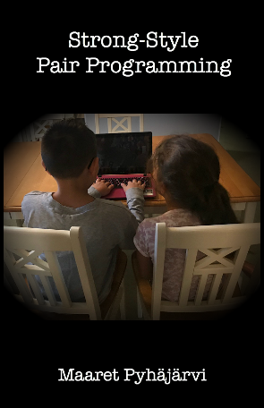
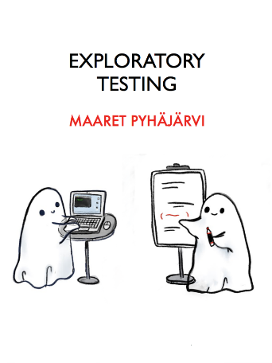
https://ensembleprogramming.xyz
https://strongstylepairprogramming.xyz
https://exploratorytesting.xyz
https://bbst.courses/blog/social-software-testing-approaches/
Notes:
14:37-14:59

Slide 11
Our Options
Notes:
15:10-16:05

Slide 12
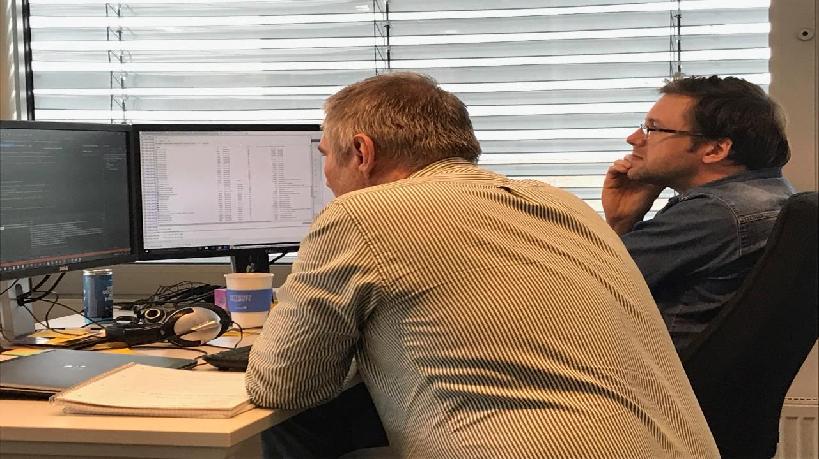
Notes:
16:05-19:09

Slide 13

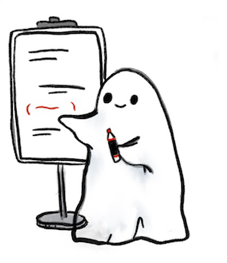
Navigator (Brains)
Driver (Hands)

Slide 14
Comparison
Traditional
Strong Style
I have an idea…
Give me the keyboard
I have an idea…
Please take the keyboard
Notes:
19:09-21:21

Slide 15
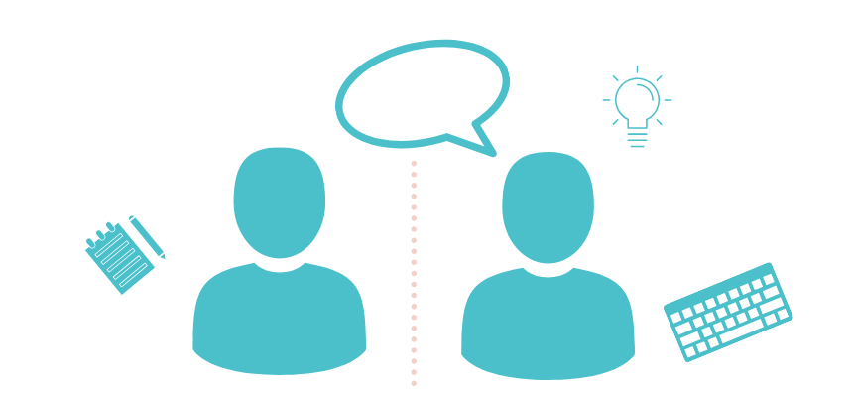
traditional pair testing
Notes:
21:21-23:47

Slide 16

Strong-style pair testing
Notes:
23:47-26:29

Slide 17
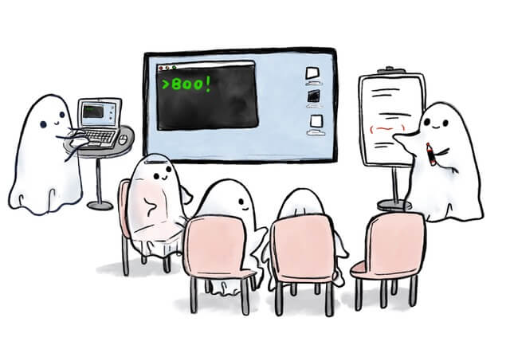
ensemble testing
Notes:
26:29-29:25
Driver – Navigator
Rotation
Retrospective
Group size

Slide 18
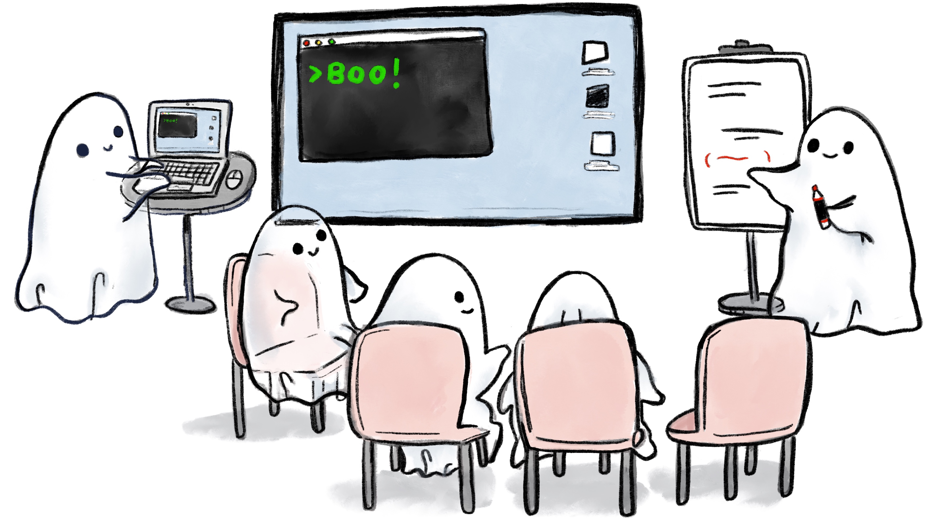
Driver (Hands)
Designated Navigator (Voice)
Navigators (Brains)

Slide 19
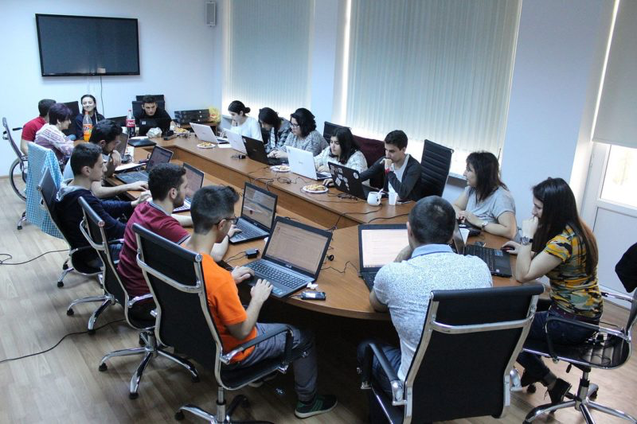
bug bashes
Image from: https://conorfi.com/software-testing/guidelines-for-running-a-bug-bash/
Notes:
29:33-32:02

Slide 20
Making Your Choices
Approach | Best Used For
Traditional Pair Testing | Working together in an equal pair requiring little rule assistance.
Strong-Style Pair Testing | Working together in an unequal pair.
Ensemble Testing | Learning and innovating a shared way of working.
Bug Bashes | Seeing problems from many perspectives.
Notes:
32:02-34:37

Slide 21
Social Software Testing Approaches are Great for…
Larger organizations where functional silos continue to exist (Testers get together to test)
Agile teams where we need to share testing skills (Teams get together to test)
Teaching anything testing related to a group (Training group gets together to test)
Introducing testing perspectives to programming activities (Testers joining ensemble programming)

Slide 22
Social Software Testing Approaches on Tour
From healing my loneliness
To Lisi Hocke’s testing tours
To many people on tour
None of this new style of deep, serendipitous learning would be possible without the social software testing approaches
Notes:
36:36-38:36

Slide 23
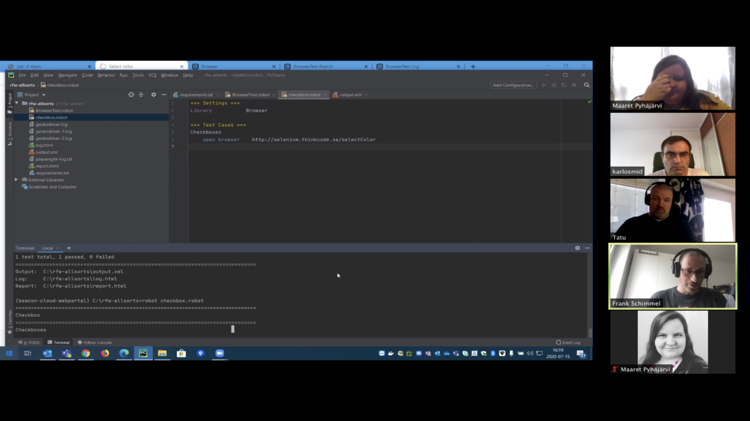
Robot Framework Browser Library in July 2020: Maaret, Frank, Karlo, Tatu
Notes:
38:36-39:20

Slide 24
Learning or Contributing
Notes:
39:20-40:01

Slide 25
Accidental Learning by being Intentional about Learning
Notes:
40:01-40:39
Figure out what goes where

Slide 26
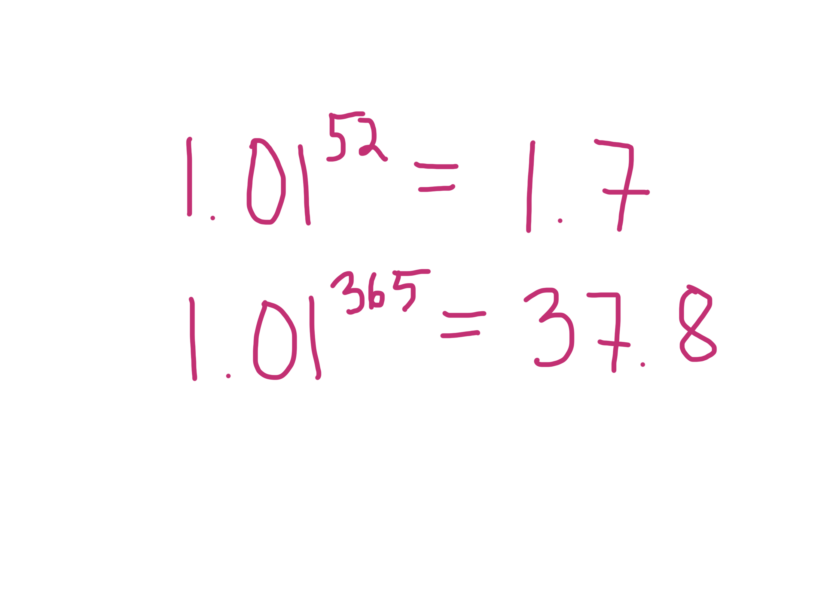
Notes:
40:39-41:20

Slide 27
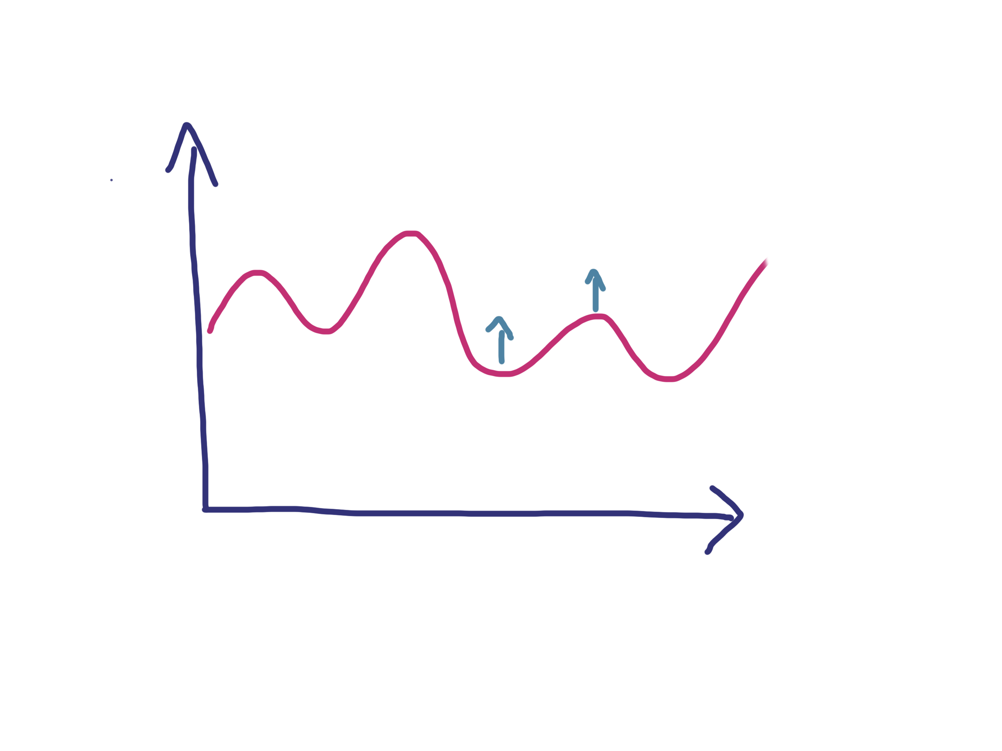
Notes:
41:20-41:50

Slide 28
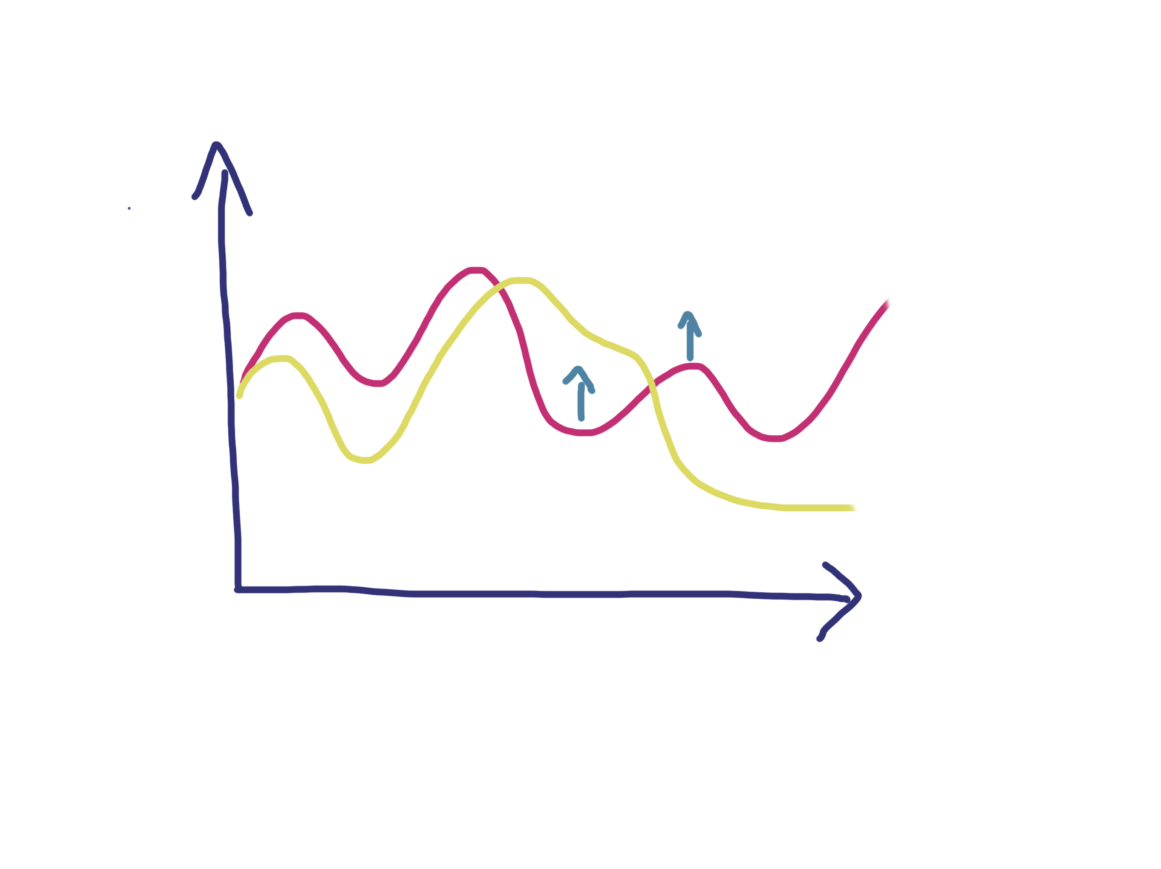
Notes:
41:50-42:20

Slide 29
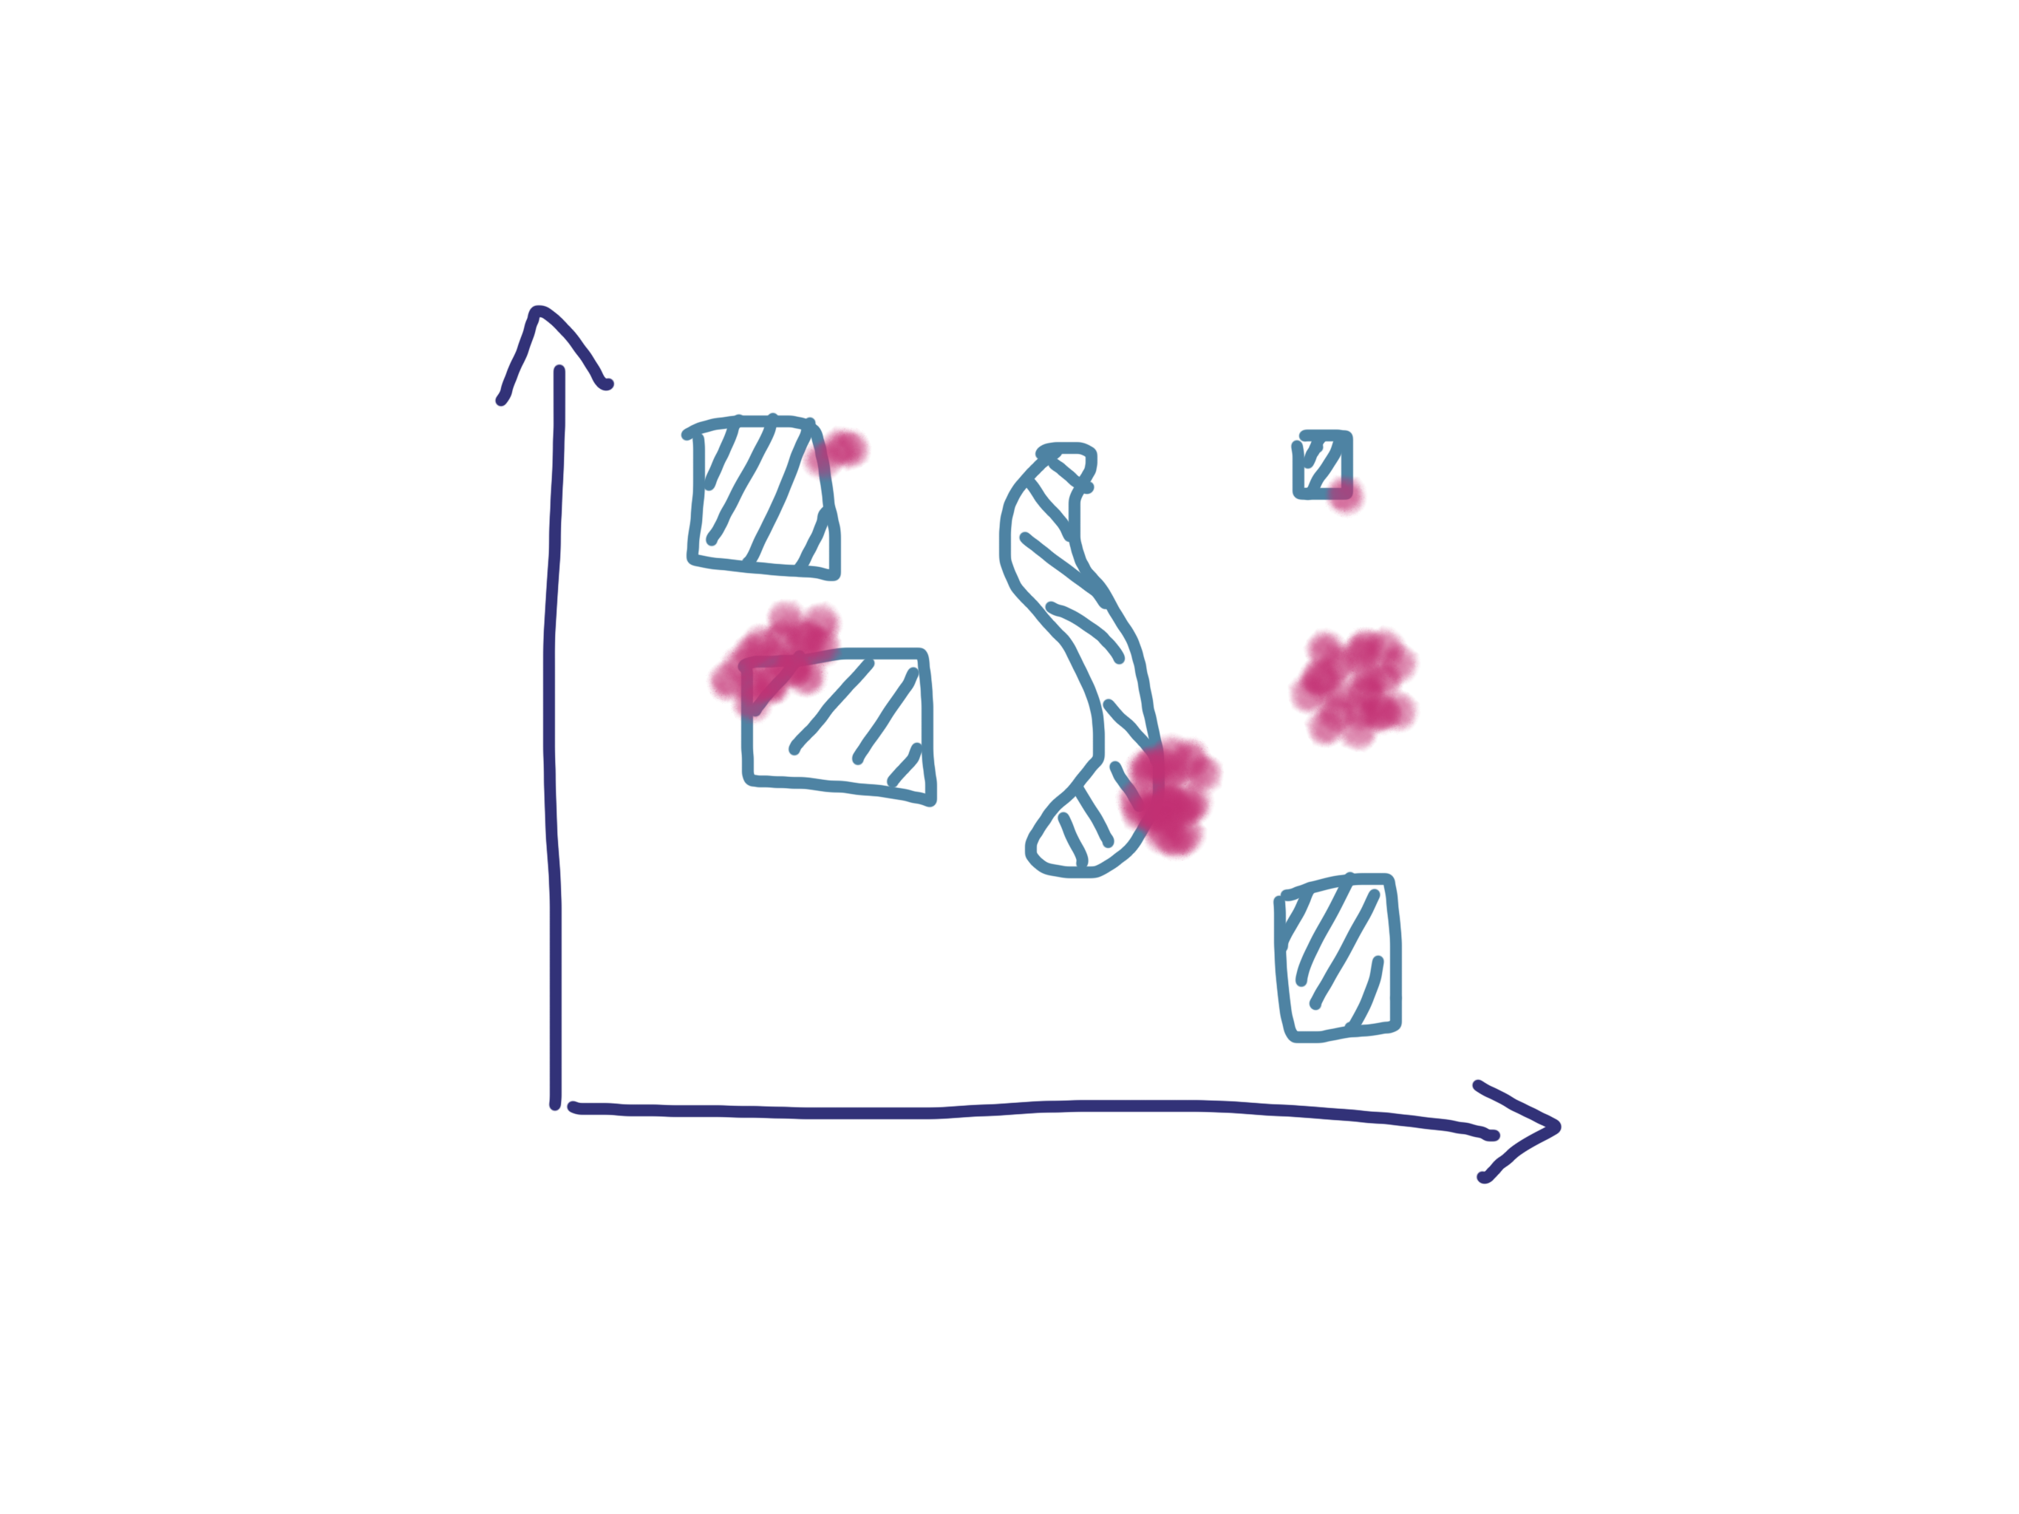
Notes:
42:20-42:53

Slide 30
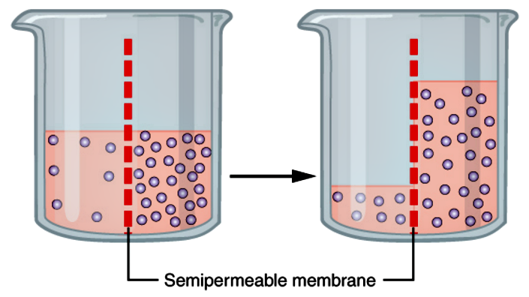
Learning Through Osmosis
Notes:
42:53-43:22
Osmosis is a process that does not require energy.

Slide 31

GenAI Pair Testing

Slide 32
I had great ideas even when I did not know how to turn them into code – removing the distance is worth the struggle.
Notes:
43:22-43:42

Slide 33
When developers like each other, code review is known as pair programming.
Notes:
43:42-44:11

